Slide 1
Customer reTENTION PROJECT
BY – Praveen Kumar singh

Slide 2


Slide 3
Abstract
Customer retention refers to the ability of a company or product to retain its customers over some specified period. High customer retention means customers of the product or business tend to return to, continue to buy or in some other way not defect to another product or business, or to non-use entirely. Selling organizations generally attempt to reduce customer defections. Customer retention starts with the first contact an organization has with a customer and continues throughout the entire lifetime of a relationship and successful retention efforts take this entire lifecycle into account. A company's ability to attract and retain new customers is related not only to its product or services, but also to the way it services its existing customers, the value the customers actually perceive as a result of utilizing the solutions, and the reputation it creates within and across the marketplace.

Slide 4
Need and motivation
With the exceptional rapid growth of the E-commerce business also come the great challenges.
Customer relationship management in the E-commerce area is one of the areas require deeper research.
In the 80‟s the marketing approach started to focus on customers than products.
The concept of relationship marketing became the major marketing approach.

Slide 5
AIM and objective
Create an effective ‘Customer Retention’ model
Validate the model’s prediction accuracy
Identify the important attributes which feed the model’s predictive power.

Slide 6
TECHNICAl requirements
Data contains 269 entries each having 71 variables.
Data contains Null values. You need to treat them using the domain knowledge and your own understanding.
Extensive EDA has to be performed to gain relationships of important variable and price.
Data contains numerical as well as categorical variable. You need to handle them accordingly.
You have to build Machine Learning models, apply regularization and determine the optimal values of Hyper Parameters.
You need to find important features which affect the ‘Recommend Retailer’.
You also need to build a Deep learning model to solve the problem and compare the performance of your finalized ML model with this DL model.

Slide 7
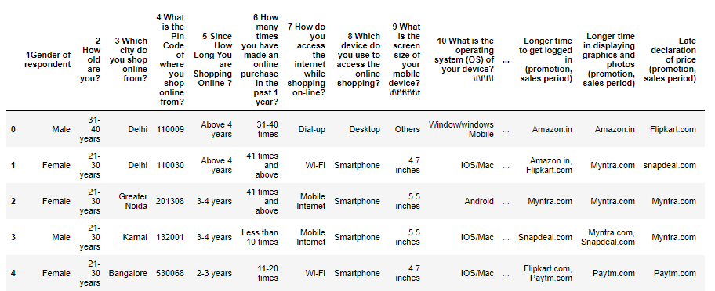
DATASET

Slide 8
Columns Of Dataset
'1Gender of respondent', '2 How old are you? ', '3 Which city do you shop online from?', '4 What is the Pin Code of where you shop online from?', '5 Since How Long You are Shopping Online ?', '6 How many times you have made an online purchase in the past 1 year?', '7 How do you access the internet while shopping on-line?', '8 Which device do you use to access the online shopping?', '9 What is the screen size of your mobile device?\t\t\t\t\t\t ', '10 What is the operating system (OS) of your device?\t\t\t\t ', '11 What browser do you run on your device to access the website?\t\t\t ', '12 Which channel did you follow to arrive at your favorite online store for the first time? ', '13 After first visit, how do you reach the online retail store?\t\t\t\t ', '14 How much time do you explore the e- retail store before making a purchase decision? ', '15 What is your preferred payment Option?\t\t\t\t\t ', '16 How frequently do you abandon (selecting an items and leaving without making payment) your shopping cart?\t\t\t\t\t\t\t ', '17 Why did you abandon the “Bag”, “Shopping Cart”?\t\t\t\t\t ', '18 The content on the website must be easy to read and understand', '19 Information on similar product to the one highlighted is important for product comparison', '20 Complete information on listed seller and product being offered is important for purchase decision.', '21 All relevant information on listed products must be stated clearly', '22 Ease of navigation in website', '23 Loading and processing speed', '24 User friendly Interface of the website', '25 Convenient Payment methods', '26 Trust that the online retail store will fulfill its part of the transaction at the stipulated time', '27 Empathy (readiness to assist with queries) towards the customers', '28 Being able to guarantee the privacy of the customer', '29 Responsiveness, availability of several communication channels (email, online rep, twitter, phone etc.)', '30 Online shopping gives monetary benefit and discounts', '31 Enjoyment is derived from shopping online', '32 Shopping online is convenient and flexible', '33 Return and replacement policy of the e-tailer is important for purchase decision', '34 Gaining access to loyalty programs is a benefit of shopping online', '35 Displaying quality Information on the website improves satisfaction of customers', '36 User derive satisfaction while shopping on a good quality website or application', '37 Net Benefit derived from shopping online can lead to users satisfaction', '38 User satisfaction cannot exist without trust', '39 Offering a wide variety of listed product in several category', '40 Provision of complete and relevant product information', '41 Monetary savings', '42 The Convenience of patronizing the online retailer', '43 Shopping on the website gives you the sense of adventure', '44 Shopping on your preferred e-tailer enhances your social status', '45 You feel gratification shopping on your favorite e-tailer', '46 Shopping on the website helps you fulfill certain roles', '47 Getting value for money spent', 'From the following, tick any (or all) of the online retailers you have shopped from; ', 'Easy to use website or application', 'Visual appealing web-page layout', 'Wild variety of product on offer', 'Complete, relevant description information of products', 'Fast loading website speed of website and application', 'Reliability of the website or application', 'Quickness to complete purchase', 'Availability of several payment options', 'Speedy order delivery ', 'Privacy of customers’ information', 'Security of customer financial information', 'Perceived Trustworthiness', 'Presence of online assistance through multi-channel', 'Longer time to get logged in (promotion, sales period)', 'Longer time in displaying graphics and photos (promotion, sales period)', 'Late declaration of price (promotion, sales period)', 'Longer page loading time (promotion, sales period)', 'Limited mode of payment on most products (promotion, sales period)', 'Longer delivery period', 'Change in website/Application design', 'Frequent disruption when moving from one page to another', 'Website is as efficient as before', 'Which of the Indian online retailer would you recommend to a friend?'

Slide 9
DATA EXploration
Data exploration is the first step in data analysis and typically involves summarizing the main characteristics of a data set, including its size, accuracy, initial patterns in the data and other attributes. It is commonly conducted by data analysts using visual analytics tools, but it can also be done in more advanced statistical software, Python. Before it can conduct analysis on data collected by multiple data sources and stored in data warehouses, an organization must know how many cases are in a data set, what variables are included, how many missing values there are and what general hypotheses the data is likely to support. An initial exploration of the data set can help answer these questions by familiarizing analysts with the data with which they are working.

Slide 10
EDA includes below steps:
Variable Identification
Univariate Analysis
Bi-variate Analysis
Missing values treatment
Outlier treatment
Variable transformation
Variable creation

Slide 11
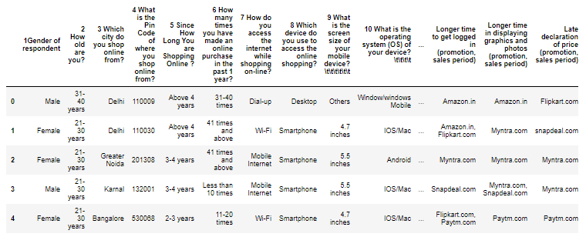
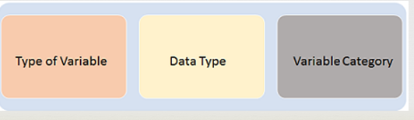
Variable identification

Slide 12
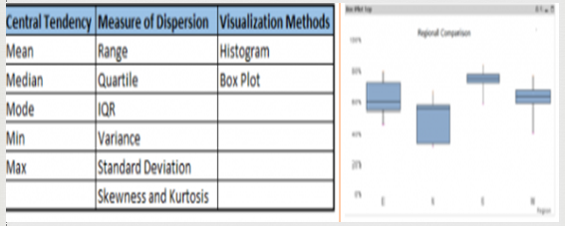
Univariate analysis

Slide 13
BI-Variate analysis
Continuous & Continuous: While doing bi-variate analysis between two continuous variables, we should look at scatter plot. It is a nifty way to find out the relationship between two variables. The pattern of scatter plot indicates the relationship between variables. The relationship can be linear or non-linear.

Slide 14
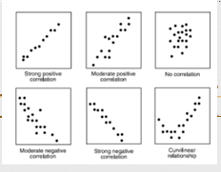
To find the strength of the relationship, we use Correlation. Correlation varies between -1 and +1.
-1: perfect negative linear correlation
+1:perfect positive linear correlation and
0: No correlation
Correlation can be derived using following formula:
Correlation = Covariance(X,Y) / SQRT( Var(X)* Var(Y))

Slide 15
What is the impact of Outliers on a dataset?
Outliers can drastically change the results of the data analysis and statistical modeling. There are numerous unfavourable impacts of outliers in the data set:
It increases the error variance and reduces the power of statistical tests
If the outliers are non-randomly distributed, they can decrease normality
They can bias or influence estimates that may be of substantive interest
They can also impact the basic assumption of Regression, ANOVA and other statistical model assumptions.

Slide 16
Data Visualization
Data visualization is the graphical representation of information and data. By using visual elements like charts, graphs, and maps, data visualization tools provide an accessible way to see and understand trends, outliers, and patterns in data. In the world of Big Data, data visualization tools and technologies are essential to analyse massive amounts of information and make data-driven decisions.

Slide 17
Data Transformation
The log transformation and square root can be used to make highly skewed distributions less skewed. This can be valuable both for making patterns in the data more interpretable and for helping to meet the assumptions of inferential statistics.

Slide 18
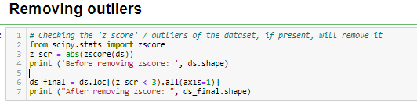

Slide 19
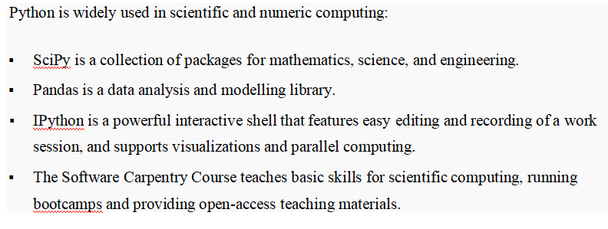

Slide 20
MODELS USED
KNeighborsClassifier
GridSearchCV
SVC
DecisionTreeClassifier
RandomForestClassifier

Slide 21


Slide 22
Conclusion
So, our Aim is achieved as we have successfully ticked all our parameters as mentioned in our Aim Column. It is seen that the all the four models, KNeighboursClassifier, SVC, DecisionTreeClassifier and RandomForestClassifier performs well. There is no definitive guide of which algorithms to use given any situation. What may work on some data sets may not necessarily work on others. Therefore, always evaluate methods using cross validation to get a reliable estimates.

Slide 23
The research results also provide tools for both real and virtual markets. On the other hand, application of the same model by targeting customers of the ready-to-wear sector can be an interesting field of study which can be used to reveal what customer do prioritize and/or value. A larger sample of countries from different nations would be appropriate to provide geographical or country level benchmark on the basis of organized ready-to-wear retailers to figure out potential differences in cultural perspectives. Carrying out similar research at other sectors and bringing out sector by sector comparisons can be used as an extensive area of research. In conclusion, this research has drawn attention to the progressive importance of customer retention sustaining efforts in ready-to-wear sector that is under intense competitive pressure.

Slide 24
LIMITATION
The thesis is conducted as a case study by basing its findings and results on a specific area where the case company operates. For the competitive advantage reason, parts that include confidential information are hidden from another version of the thesis. Empirical data received from the interview and the focus group is not suitable for generalized usage due to its focused, one company orientation.

